Slide 1
Media studies gcse for 2021/2022
Media Studies
Needs YOU!!!

Slide 2
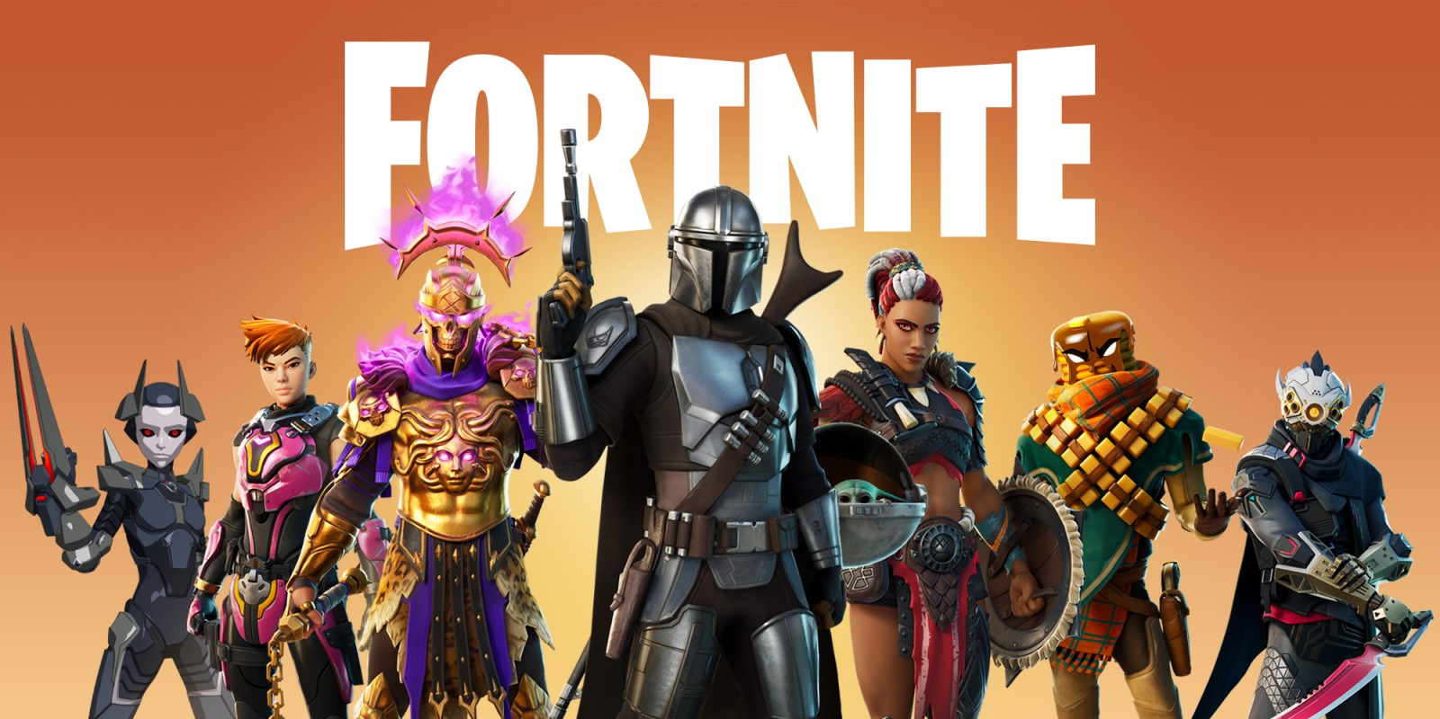
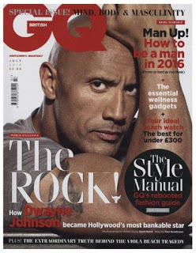
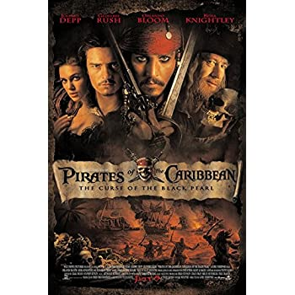
What will I study in media studies gcse?
Computer Games - Fortnite
Newspapers and Magazines
Film Posters

Slide 3
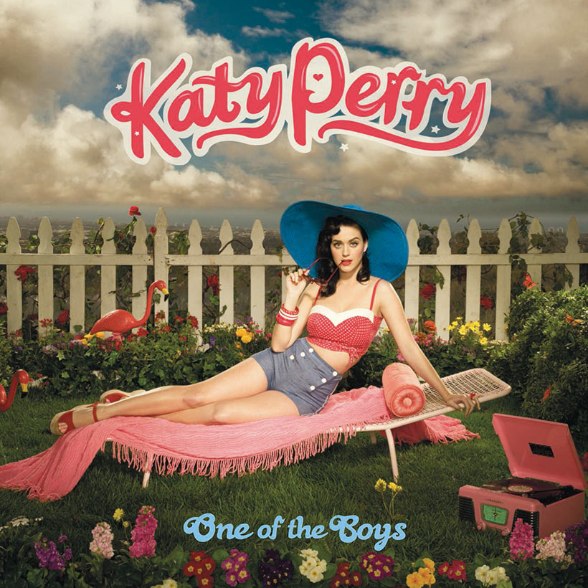
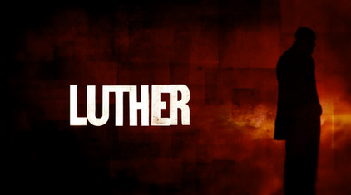
What else will I study?
Music videos
TV and Radio Dramas
Advertising

Slide 4
How is media studies assessed?
Yes, there are two exams. Both an hour and a half long. The first one covers film posters, such as James bond, adverts such as Quality Street and video games such as Fornite!
The second paper focuses on music videos such as Uptown Funk by Bruno Mars, Rio by Duran Duran and Roar by Katy Perry. You will also study one episode of Luther in great detail.
There is a coursework component worth 30% of the GCSE whereby you will create a product.
Options have included, magazine front cover and double page spread, DVD box and poster or even a music video or web site. This all needs to be your own work and all your own photographs so great if you are creative and like making things.

Slide 5
Why choose media studies?
Further Education
Careers
A Level Media Studies
Not only is Media Studies interesting and relevant, it gives you valuable skills to help understand the world around you. You can apply many of these skills to GCSE English too – students often do better in English when they take Media Studies as well.
Presenter.
Advertising Media Buyer.
Copywriter.
Blogger.
Media Researcher.
Broadcast Journalist.
Writer.
Social Media Manager.

Slide 6
What do I do next if I am interested in taking media studies?
If you are interested in taking this exciting, modern and relevant GCSE then please contact to ask questions or discuss.
Ms Cellupica on mcellupica@wbvs.co.uk
Mr Moore on
jmoore@wbvs.co.uk

